Slide 1
Research @ DIS
orientation
spring 2020
Dr. Carla Caetano
Senior Consultant in Research Development
Dr. Jeanette Erbo Wern
DIS faculty, Science & Health
Ms. Kenzie Zimmer
Research Coordinator
Dr. Tina Mangieri
DIS Associate Academic Director & faculty

Slide 2
agenda
introductions
DIS research assistantships
assignments & evaluation
workshops
being a research student
research mentors
note to self…
initial meetings & logistics

Slide 3
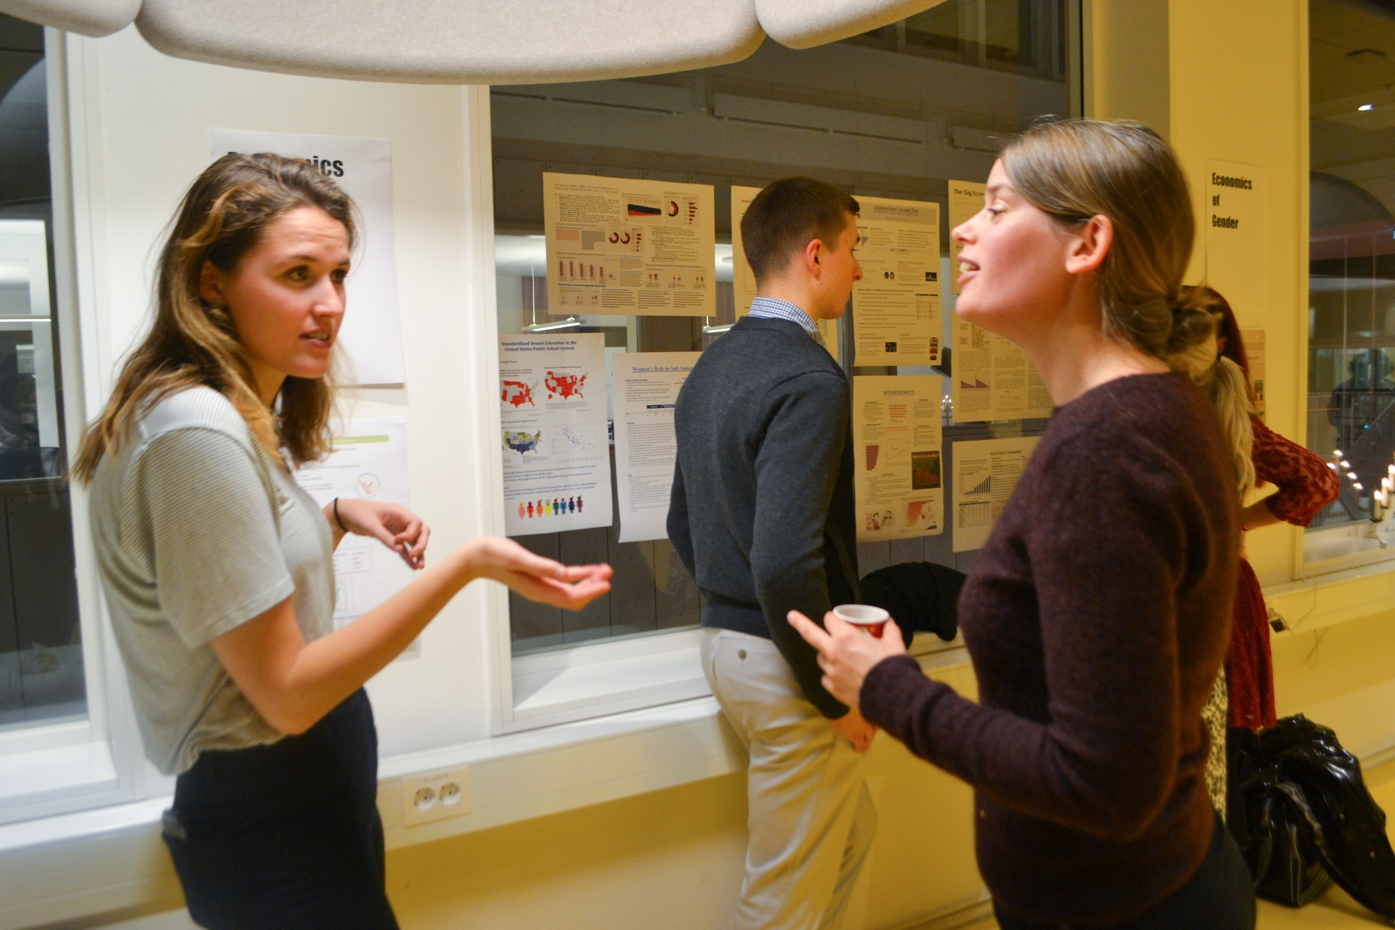
Who are you?
Why research at DIS?

Slide 4
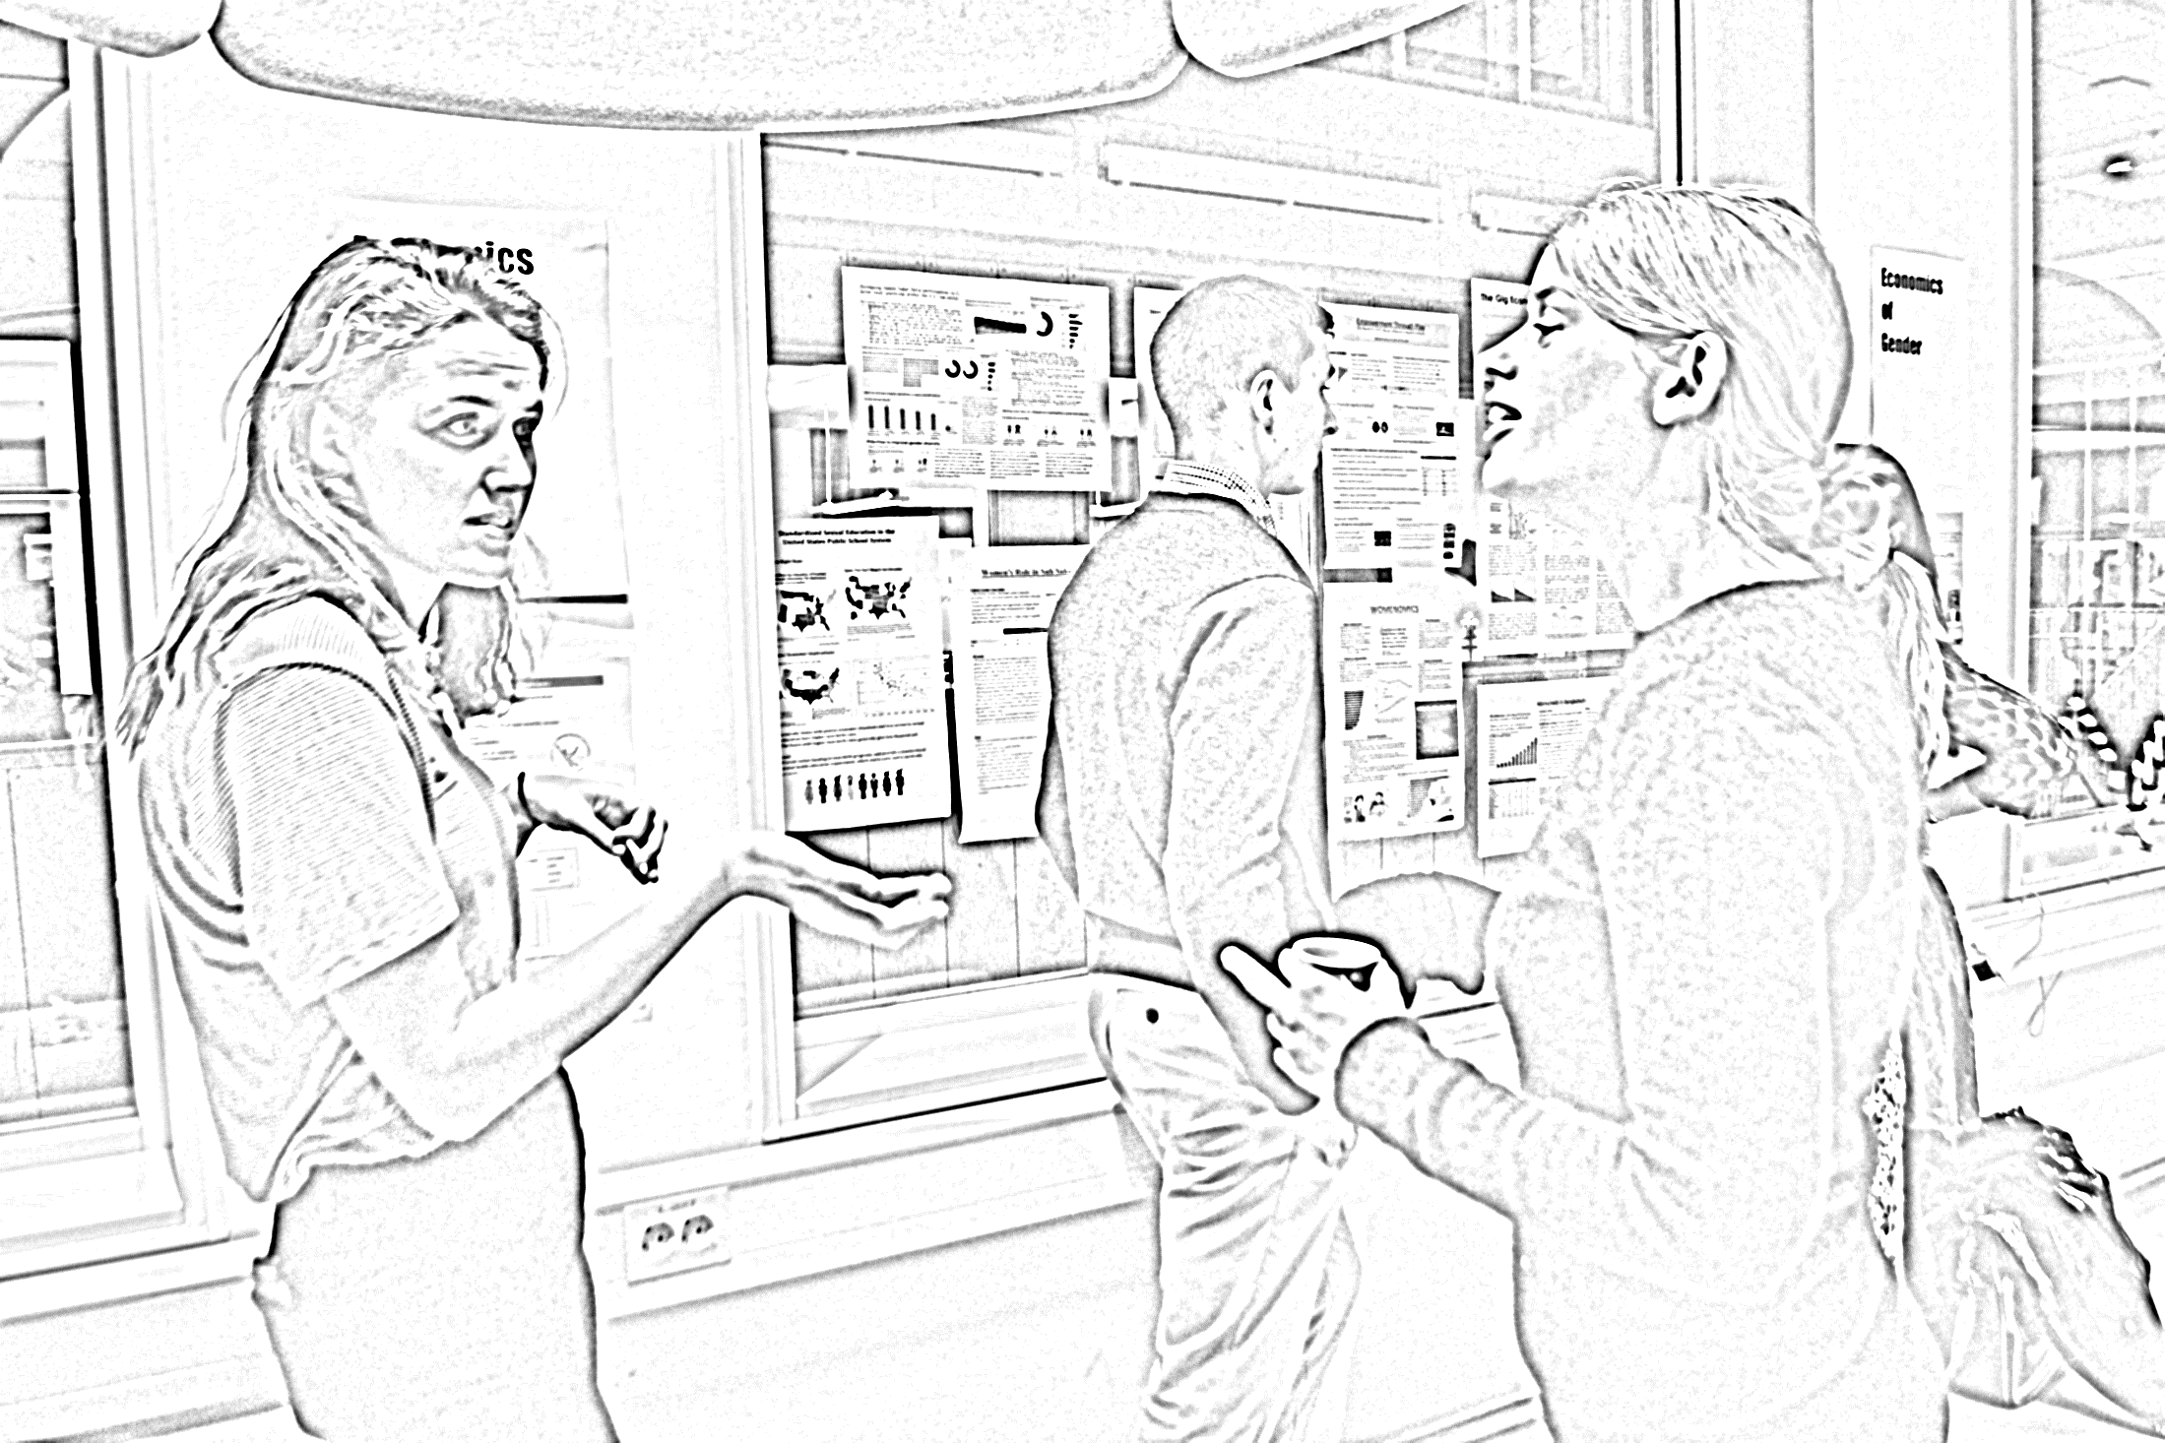
name
major
school
research project
Who are you?
Why research at DIS?

Slide 5
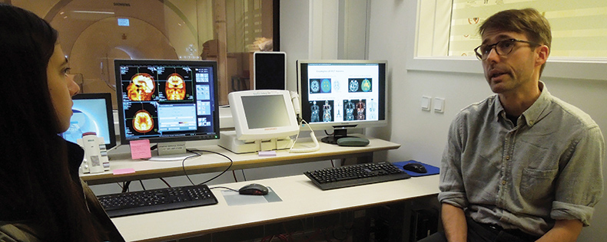
DIS research assistantships
Notes:
Opportunity to gain hands-on, mentored, experience by conducting research in an international setting as a participant in an existing research project.
Differences between 3- and 6-credit research projects.
Projects represent multiple disciplines &, therefore, varying approaches & norms
In some cases, you will be part of a large research group (primarily those of you in the 6-credit RAships). Others will be single individuals or part of a small team of fellow students.
Some will have the chance to co-design their contribution to the research project and others will be offered a topic selected by your mentors.
All of you will need to be self-advocates, excellent communicators, individually & intrinsically-motivated, able to set and adhere to deadlines, to work autonomously, focused, and flexible.

Slide 6
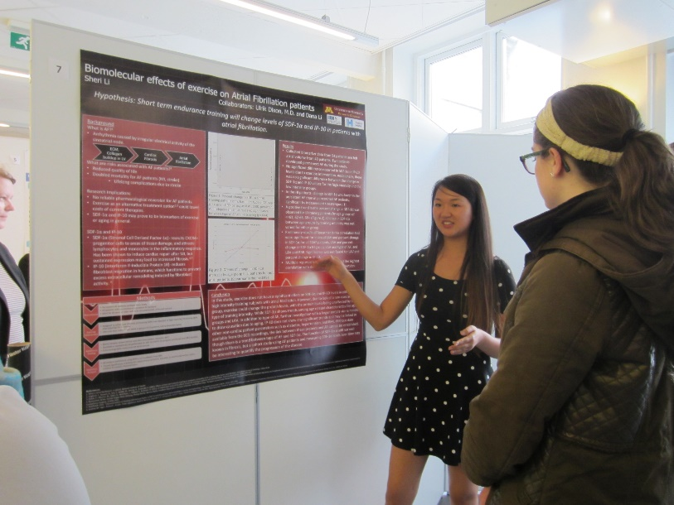
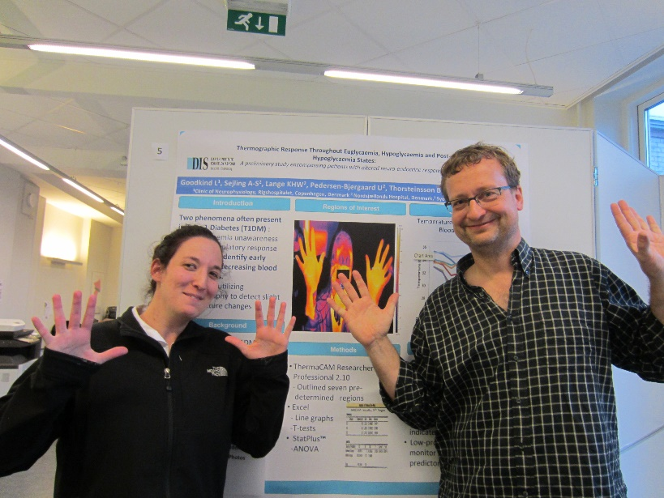
assignments & evaluation
3-credit Research Assistantships:
each project has assignments that differ
please refer to your syllabus on Canvas
6-credit Research Assistantships:
literature summary review
outline of research project
abstract / poster
research paper
participation
more info on Canvas
Research Symposium
DIS End-of-Semester Showcase
Wednesday, 6 May, 15.00-17.00

Slide 7
workshops
Wednesdays: 17.15 – 18.45
Workshop 1
19 February
Research Process
Workshop 2
15 April
Communicating Research Findings

Slide 8
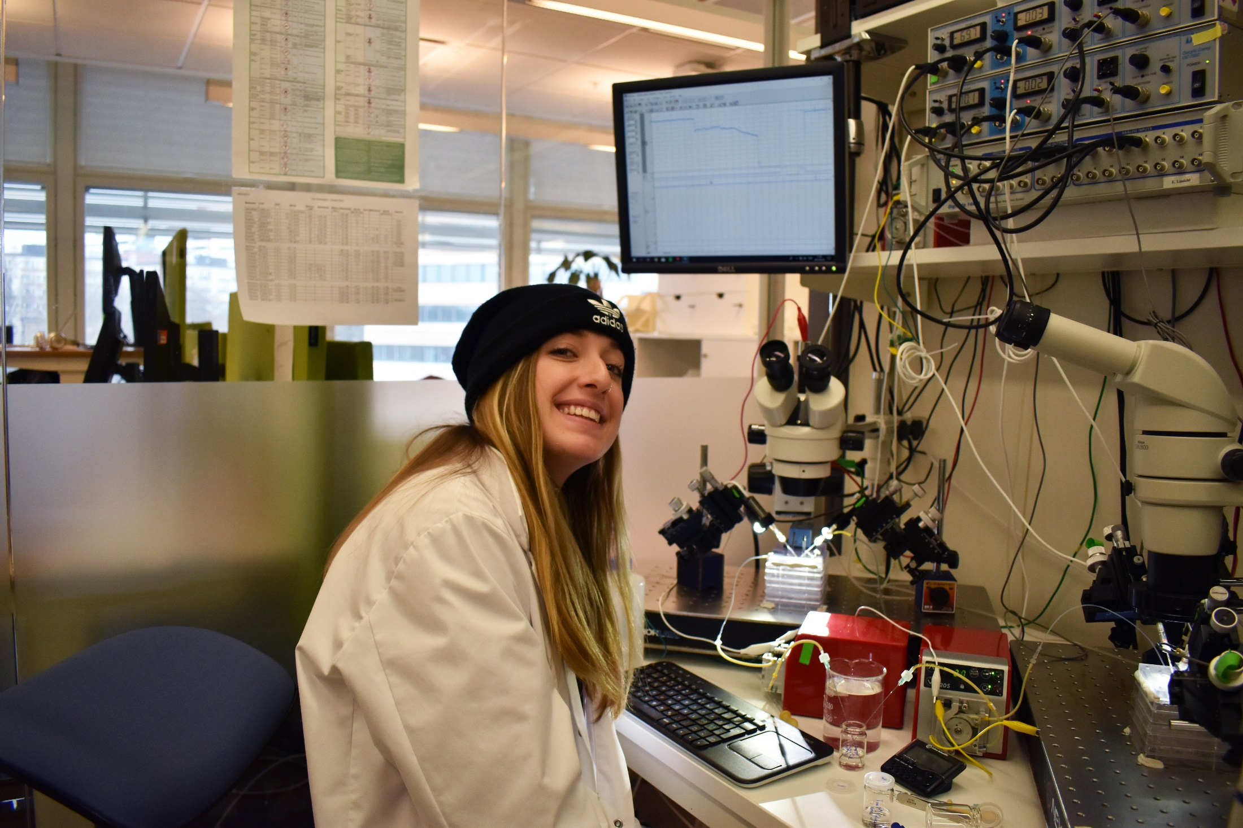
you & research
Notes:
Picture Card Activity

Slide 9
being a research student
What personal attributes will you need/use/practice
as a research student this semester?
What challenges do you expect to face?
What are you excited about?

Slide 10
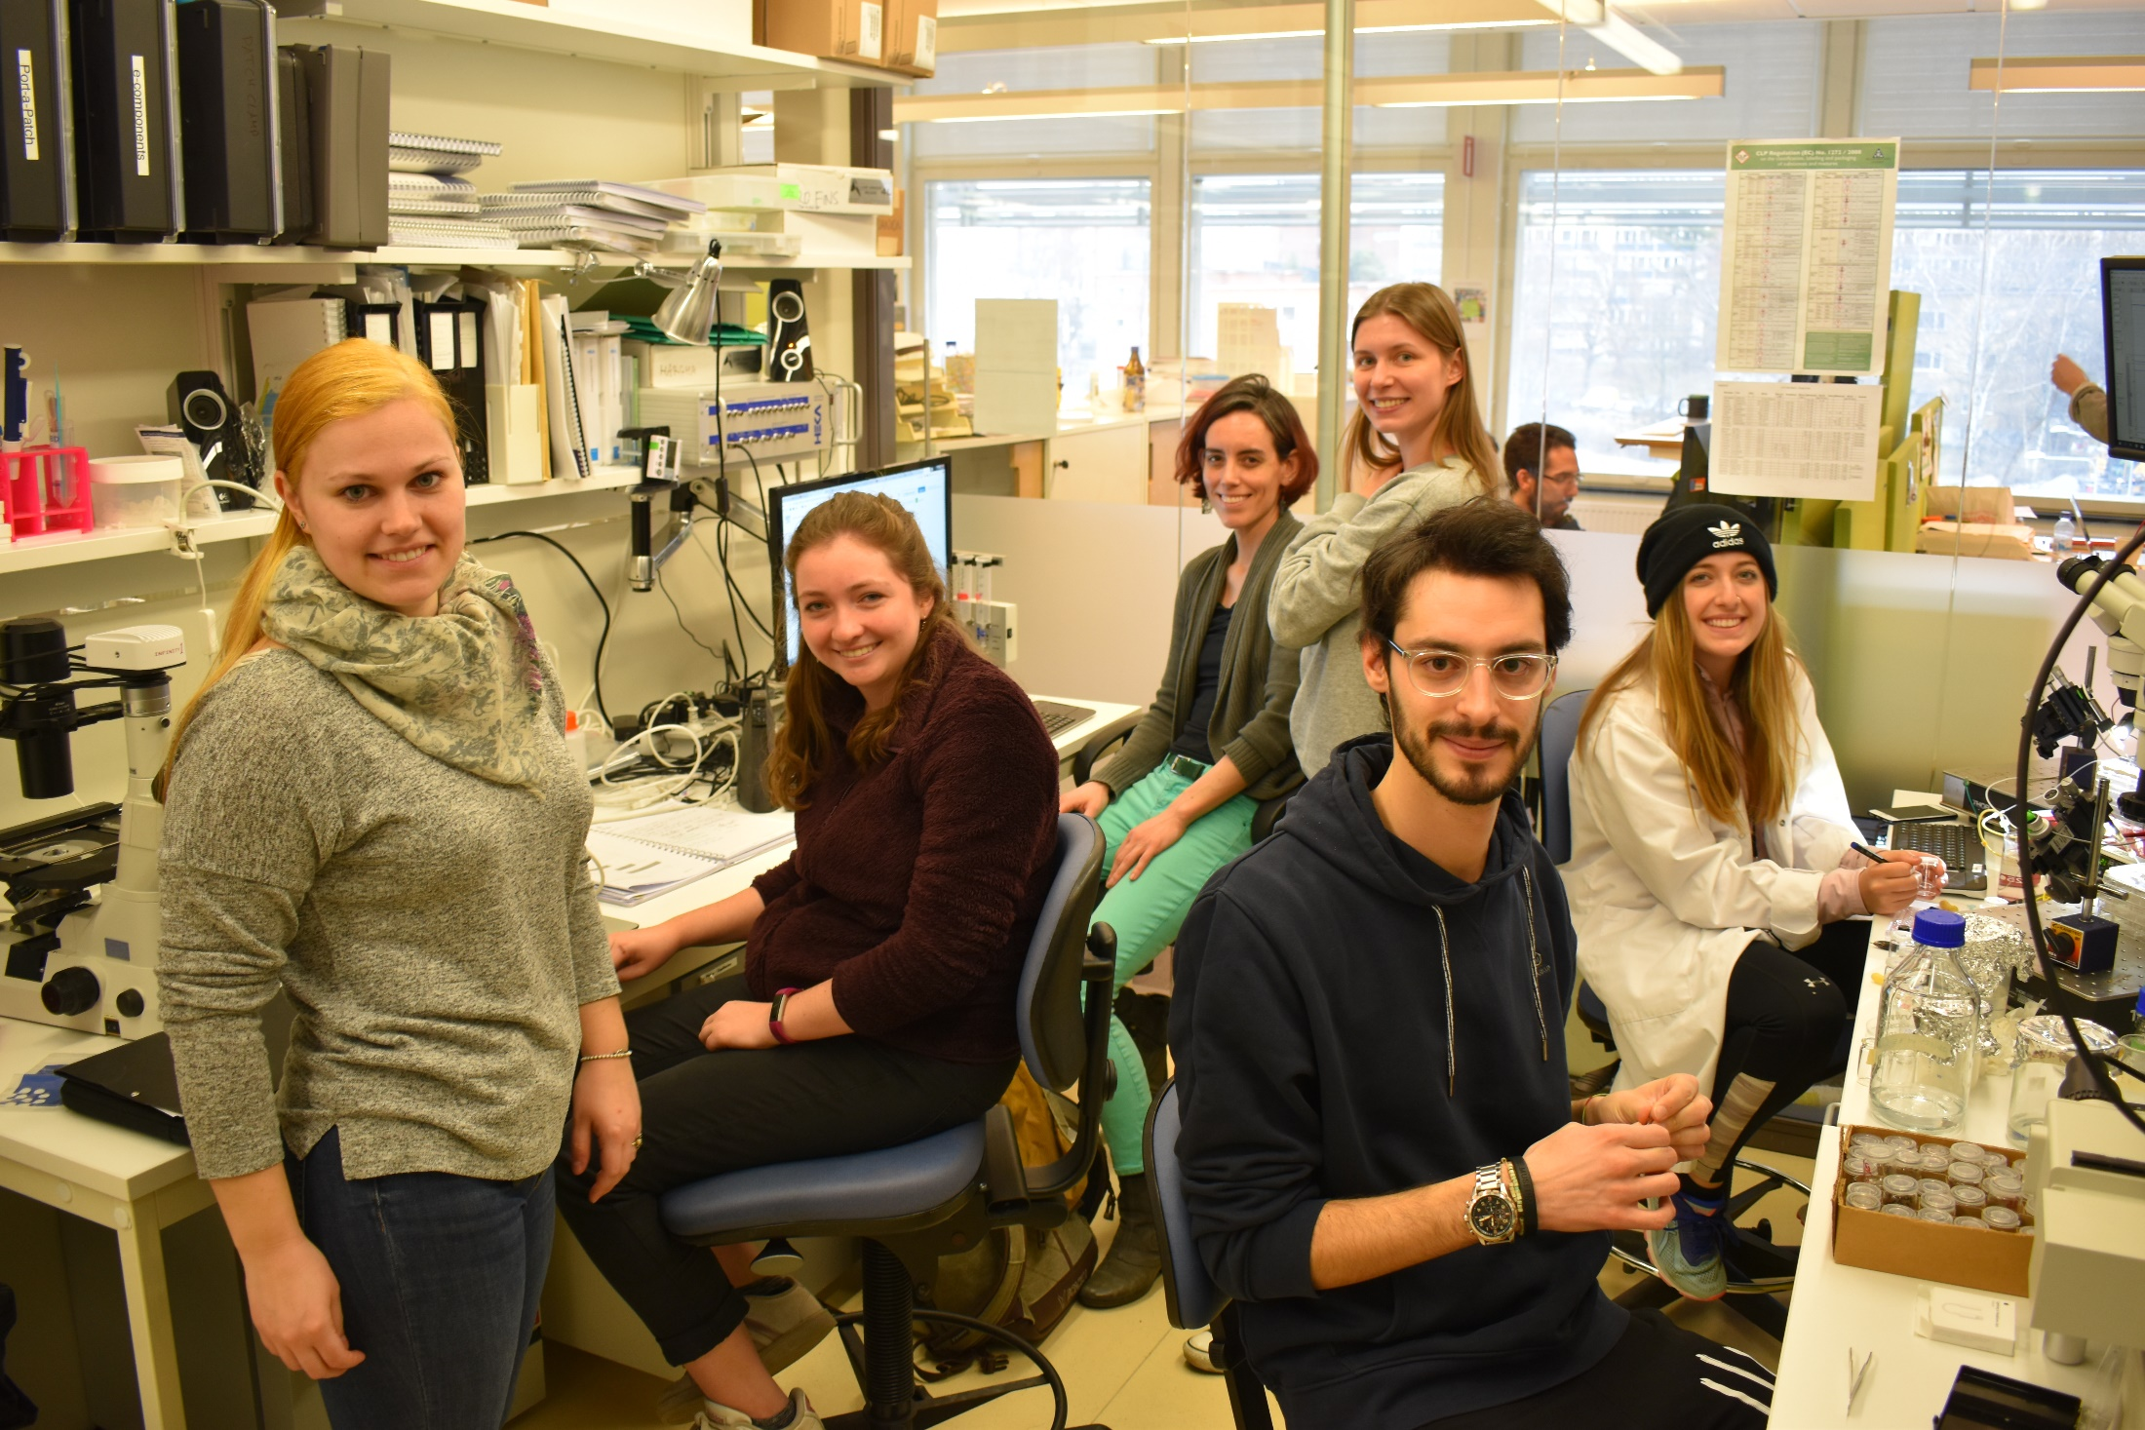
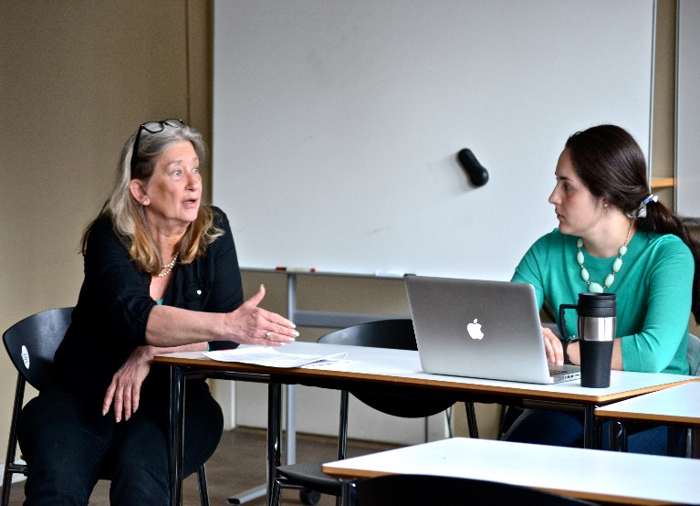
observe your surroundings
research mentors & research environments
Who is your research mentor?
Professionally - where have they been, where are they going?
How many ‘hats’ do they wear? Clinician, Researcher, Professor...
Is there collaborative practice within your research project?
What is the research culture?

Slide 11
note to self
Following the
research symposium,
at the end of the semester,
I hope to have learned / experienced ….

Slide 12
initial meetings & logistics
prepare
reading material
questions to ask your mentor
know your semester schedule
(including CCW, Study Tours, Field Studie & DIS breaks)
communicate
throughout the semester, you must initiate communication
ask questions (if something is unclear, if you need more info, etc.)
transportation
6-credit research students only
note
meeting time & location
directions
mentor contact information

Slide 13
research@dis.dk

